Slide 1
ENGR 400/LENGR 400 ETHICS IN ENGINEERING AND SCIENCE
Chapter 4
Ethical Problem Solving Techniques
ORAL ANSEN

Slide 2
Chapter 4 Outline
Analyzing Ethical Problems
Factual Issues
Conceptual Issues
Moral Issues
Sample Cases
Ethical Problem Solving Techniques
Line Drawing Technique
Flow Charting Technique
Sample Cases

Slide 3
Analyzing Ethical Problems
First step in solving any ethical problem is to completely understand the problem and all of the issues involved, and to list them
Then, frequently a solution to the ethical problem becomes more apparent

Slide 4
Issues involved in Analyzing Ethical Problems
Three categories of issues involved in analyzing ethical problems:
Factual Issues (what is factually known)
Conceptual Issues (definition and applicability of concepts)
Moral Issues (which moral principle applies)
Harris, Pritchard and Rabins, 2000

Slide 5
Factual Issues
Factual issues are what is factually known about an ethical problem
A factual issue may have sometimes two characteristics, when;
there is a disagreement over a matter of fact,
this matter of fact is crucial to resolving the problem
A fact, unlike a factual issue, is a matter that has already been settled and is unquestionable

Slide 6
Factual Issues
Factual issues arise, for example, in case we do not know;
what the effects of a certain course of action will be,
what risks are involved in a certain technology,
how much a certain modification in a design will cost,
how accurate a given test is.

Slide 7
Factual Issues
Factual issues seem easy, but are not always clear and may be open to questioning, due to unclear facts
Was the given gift offered or requested?

Slide 8
Conceptual Issues
A conceptual issue is a disagreement over a definition, or meaning, or applicability of a concept that is crucial to resolve an ethical problem

Slide 9
Conceptual Issues
Conceptual issues are also sometimes not clear cut and they are open to questioning;
how to determine whether certain business information is confidential or not,
two engineers may not be in agreement about
whether a given action is a conflict of interest, because they may have different definitions of “conflict of interest”,
whether something is a bribe, or an acceptable gift, because they have different conceptions of a bribe

Slide 10
Gift and Bribe
Giving gifts is an ancient way to express gratitude, appreciation and love
But some gifts tend to put pressure on the receiver to make more than just goodwill to the giver
In that case a gift given becomes a bribe to influence the receiver's conduct in favor of the giver
Thus, accepting gifts and bribery have a thin line between them

Slide 11
Gift and Bribe
Bribery is the offering, giving, receiving, or asking of any item of value that influence the actions of an official or other person in charge of power to secure an advantage or to manipulate a decision
Bribes can be in many forms, such as; money, gift, fee, property, free ticket/trip, sex, a favor, etc.
Bribery is unethical and illegal everywhere in the world

Slide 12
Gift and Bribe
Bribes are usually given:
To win or retain business
To speed up procedures
To get routine administrative approvals
To influence people to deliver favorable treatment
To use unauthorized resources
To get confidential information
Source: KPMG

Slide 13
Gift and Bribe
Frequently, engineers find themselves in the position of;
either dealing with suppliers who wish to sell them inputs, or
dealing with customers to sell their company products
In this connection a gray area of engineering ethics is;
the acceptance of gifts from sellers, or
the offering of gifts to buyers to secure business

Slide 14
Gift and Bribe
When is a gift a bribe?
Frequently, the boundary between a reasonable gift and a bribe is very difficult to define, because of the potential for gifts to become bribes, or to be perceived of as bribes
In case of bribe the value of the gift is probably a well-known fact
What is not known is whether accepting it leads to any one-sided decision in favor of the giver
e.g.; receiver taking a particular unfair action

Slide 15
Gift and Bribe
When is a gift a bribe?
Gifts of nominal value, such as coffee mugs or calendars with a vendor’s logo and phone number on it, are really just an advertising tool
Generally, there is no problem with accepting such type of items
Dining with a customer or a supplier is an acceptable practice, especially, if it is reciprocal
However, when meals are no longer of low cost and the expense is not shared equally, the possibility for abuse becomes large

Slide 16
Bribery and Corruption
Bribery corrupts free-market economic system and competition
Corruption is the misuse of entrusted power for private or company gain
It involves many issues, one of which is the issue of bribery
Currently, bribery and corruption is being addressed by many organizations around the world such as, ‘‘Transparency International’’
www.transparency.org
Copyright © 2015 Pearson Education Ltd.

Slide 17
Bribery and Corruption
‘‘Transparency International’’ defines corruption as ‘‘the abuse of entrusted power for private gain;
it can be classified as big, minor and political depending on the amounts of money lost and the sector where it occurs’’
Transparency International announces bribery rates around the world on yearly basis under the heading ‘‘Corruption Perceptions Index’’
www.transparency.org

Slide 18
Bribery and Corruption
Transparency International Index;
ranks 180 countries and territories by their perceived levels of public sector corruption according to experts and businesspeople
2018 index reveals that the continued failure of most countries to significantly control corruption is contributing to a crisis in democracy around the world
while there are exceptions, the data shows that despite some progress, most countries are failing to make serious inroads against corruption
www.transparency.org/cpi2018

Slide 19
Bribery and Corruption
so it is not so surprising that the majority of people around the world do not think governments are doing well fighting corruption
corruption in public procurement harms the public interest, undermines public trust and has a negative impact on people’s lives
corruption corrodes the fabric of society, and it weakens people’s trust in political and economic systems, institutions and leaders
It can cost people their freedom, health, money – and even their lives in corrupted countries
www.transparency.org & www.seffaflik.org

Slide 20
Bribery – A Sample Case The Coca-Cola Egypt
In the 1970s, the Coca-Cola managers were expected to pay bribes to Egyptian officials for doing business in Egypt.
But, they did not pay bribes.
Instead, they hired hundreds of Egyptians to plant orange trees on thousands of acres of desert.
As a result, they created goodwill with Egypt and the Egyptian officials signed the contracts with Coca-Cola without bribery.
Harris, Pritchard, Rabins. (2005). Engineering Ethics, Wadsworth, p. 71.

Slide 21
Moral Issues
Once the factual and conceptual issues have been resolved at least to the extent possible, determination of which moral issue applies is usually more clear and then the correct decision becomes more obvious
For example; when a gift is determined whether it is simply a gift or is really a bribe, then the appropriate action is obvious
If we determine that it is indeed a bribe, then it cannot be morally acceptable

Slide 22
How to Analyze Issues involved in Ethical Problems
The basic approach
Factual Issues – Find out what is factually known about a case
Conceptual Issues – Agree on definitions and applicability of concepts
Moral Issues – Then, apply relevant principles

Slide 23
How to Analyze Issues involved in Ethical Problems
Factual Issues
Are determined through research to establish the truth
It is not always possible to achieve a final determination of the truth that everyone can agree on
Generally further research;
helps clarify the situation,
can increase the areas of agreement,
can sometimes achieve consensus on the facts

Slide 24
How to Analyze Issues involved in Ethical Problems
Conceptual Issues
Are determined by agreeing on the definition, or meaning, or applicability of concepts
Sometimes agreement isn't possible
As with factual issues further analysis of the concepts at least clarifies some of the issues and helps to facilitate agreement
Moral Issues
Are determined by agreement as to which moral principle is more relevant and how it should be applied

Slide 25
Factual, Conceptual and Moral Issues
Sample Case
Paradyne Computers

Slide 26
Incident
In 1980 the Social Security Administration (SSA) published a request for proposals for computer systems to replace the older equipment in its field offices
SSA wanted to purchase an off-the-shelf system currently existing in the vendor’s product line, rather than a new system

Slide 27
Incident
But, Paradyne company bid to supply a new computer system
Problems occurred immediately when the Paradyne computers failed the acceptance testing because the product supplied by Paradyne was not an off-the-shelf system

Slide 28
Incident
Paradyne in their bid wrote in the present tense, as if the computer they proposed currently existed, rather than in the future tense, which would have indicated that the product was still under development
Paradyne claimed that the use of the present tense in their bid was acceptable, since it is a common business practice to advertise products under development this way

Slide 29
Factual Issues
The request for proposals clearly specified that only already existing systems would be considered
Paradyne didn’t have any such system running and have never tested the operating system on the product they actually proposed to sell to the SSA
Under these conditions, the factual issues do not appear to be questionable

Slide 30
Conceptual Issues
Whether bidding to provide an off-the-shelf product when the actual product is only in the planning stages is lying or is an acceptable business practice? (Lying)
Is placing a Paradyne label over the real manufacturer’s label dishonest or not? (Dishonest)

Slide 31
Moral Issues
Is lying an acceptable business practice?
Is it alright to be dishonest, if doing so allows your company to get a contract?
The answer to these questions are obvious: Lying and dishonesty are no more acceptable in your business life than in your personal life
So, if conceptually we decide that Paradyne’s practices were dishonest, then our analysis indicates that their actions were unethical

Slide 32
Ethical Problem Solving Techniques
In solving engineering problems, we look for an appropriate formula, plug in the numbers, and calculate an answer
This type of problem solving approach is useful for engineering problems, however, it is not as useful for ethical problems as there are usually no formulas for reaching a single solution in ethics

Slide 33
Ethical Problem Solving Techniques
We studied in Chapter 3 ethical approaches, principles and theories that help us to frame our understanding of ethical problems
In this part, we will examine some techniques used for solving ethical problems and learn how they are applied

Slide 34
Ethical Problem Solving Techniques
Two common techniques used in ethical problem solving:
Line Drawing Technique
Flow Charting Technique

Slide 35
Line Drawing Technique
Useful for situations in which the applicable moral principles are clear, but there seems to be great deal of ‘‘gray area’’ about which ethical principle or theory applies
Line drawing is performed by drawing a line along which two paradigms (examples) and various hypothetical situations and the problem are placed

Slide 36
Line Drawing Technique
Negative Paradigm Positive Paradigm
(NP) (PP)
“Hypothetical considerations” and the “Problem”
are placed on this line where they belong to
Something that is definitely unacceptable
Something that is definitely acceptable

Slide 37
Line Drawing Technique
At the left end of the horizontal line, the negative paradigm “NP” is placed
an example of something that is definitely morally unacceptable
At the right end of the horizontal line, the positive paradigm “PP” is placed
an example of something that is definitely morally acceptable

Slide 38
Line Drawing Technique
Then, “hypothetical considerations” are placed in between “NP” and “PP”, by moral relevancy:
Those hypothetical considerations that are morally unacceptable are placed closer to the negative paradigm
Those hypothetical considerations that are morally acceptable are placed closer to the positive paradigm
The technique works only if they are placed objectively and honestly

Slide 39
Line Drawing Technique
Next, actual situation being judged the moral problem “P” is placed on the horizontal line by carefully examining the line drawing to determine;
where it fits relative to the entries of hypothetical examples, and
whether the problem is closer to the positive or negative paradigm

Slide 40
Line Drawing Technique
Sample Case
Dispose of
Slightly Toxic Waste

Slide 41
Dispose of Slightly Toxic Waste
A company would like to dispose of toxic waste (slightly hazardous) by dumping it into a local lake
But from this lake a nearby town gets its drinking water
How can we determine if this practice is acceptable?
Let us start by defining the problem, and the positive and negative paradigms

Slide 42
Problem
A company wants to dispose waste in a lake
The lake supply water for a village
Environmental Protecting Agency (EPA) limit 10 ppm chemical concentration
Average chemical concentration of the disposal is 5 ppm
At 5 ppm; company expects; no health problems, and consumers would not be able to detect or taste the chemical in their drinking water

Slide 43
Positive Paradigm and Negative Paradigm
Positive Paradigm
The water supply for the town should be clean and safe
Negative Paradigm
Toxic levels of waste are dumped into the lake

Slide 44
Positive Paradigm and Negative Paradigm Placed on the Line
Negative Paradigm Positive Paradigm
(NP) (PP)
Dump toxic levels of waste in lake
Water should be clean and safe

Slide 45
Hypothetical Considerations
The company dumps the toxic waste into the lake at 5 ppm (limit 10 ppm); the toxic waste will be harmless, but the town water will have an unusual taste
The toxic waste can be effectively removed by the towns existing water treatment system

Slide 46
Hypothetical Considerations
The toxic waste can be removed by the town with new equipment for which the company will pay
The toxic waste can be removed by the town with new equipment for which the taxpayer will pay

Slide 47
Hypothetical Considerations
Occasionally exposure to the toxic waste can make people feel it, but this only lasts for an hour and is rare
Some people can get fairly sick, but the sickness only lasts a week and there is no long term harm
Equipment can be installed by the company at the plant to further reduce the toxic waste level to 1 ppm

Slide 48
Hypothetical Considerations
One could go on for a long time creating more and more hypothetical considerations
Generally where the problem fits along the line is obvious with only with a few hypothetical considerations, but the exercise should be continued with more hypothetical considerations until it is clear what the proper resolution is

Slide 49
Hypothetical Considerations Summarized
Dump 5 ppm toxic waste in lake; harmless, but unusual taste
Town’s water-treatment system can effectively remove toxic waste
Town can remove toxic waste with company-purchased equipment
Town can remove toxic waste with taxpayer-purchased equipment
Occasional (rare) illness, lasts for an hour
People get fairly sick, lasts one week, no long term effect
Company can reduce ppm to “1”

Slide 50
Hypothetical Considerations Placed on the Line
Negative Paradigm Positive Paradigm
(NP) (PP)
6 5 4 1 7 2,3
Dump toxic levels of waste in lake
Water should be clean and safe

Slide 51
Hypothetical Considerations Placed on the Line
Note that there is some subjectivity in determining exactly where along the line each of the hypothetical examples fit
If there is a gap in the knowledge, then more information might be gathered on;
seasonal variations in toxic waste concentration and water usage of the town
potential interactions of the toxic waste with other pollutants such as runoff of pesticides from local farms
Finally, the problem “P” is inserted among the hypothetical examples where it fits

Slide 52
Problem “P” Placed on the Line
Negative Paradigm Positive Paradigm
(NP) (PP)
6 5 4 1 P 7 2,3
Dump toxic levels of waste in lake
Water should be clean and safe
Our problem “P” is considered to fit between hypothetical examples 1 and 7 along the line

Slide 53
Dispose of Slightly Toxic Waste
It is clear that dumping the toxic waste is probably a morally acceptable choice since the toxic waste levels will be well below the legal limit that could cause any harm
Since the problem is somewhat far from the positive paradigm then there are probably better choices that can be made
The company should investigate those better alternatives

Slide 54
Dispose of Slightly Toxic Waste
This example illustrates that line drawing can help solve the ethical aspects of a problem, but there are many other considerations for final decision:
Political aspects should be taken under consideration
Many people in the community are likely to regard the dumping of a toxin at any level as unacceptable
Good community relations might dictate that a better solution should be pursued instead

Slide 55
Flow Charting Technique
Flow charting technique is used in:
Engineering ethics
especially when a sequence of events to be considered, or
a series of consequences flows from a decision
Almost all engineering branches
Describing business processes and procedures
For further info refer to: http://asq.org/learn-about-quality/process- analysis-tools/overview/flowchart.html

Slide 56
Flow Charting Technique
Provides a visual picture and readily allows one to see results of each decision
“Yes or No” answer at each step will take us to another decision making step
For effectively solving ethical problems by the use of flow charts, it is important;
to be creative in determining possible outcomes of possible actions and scenarios, and
to be objective and honest as possible
otherwise it will be possible to draw any conclusion one wants, even it is clearly wrong

Slide 57
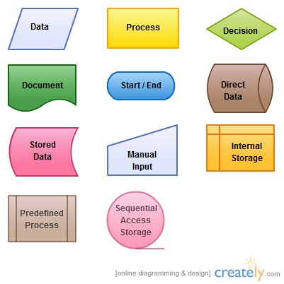
Flow Chart Symbol Meanings

Slide 58
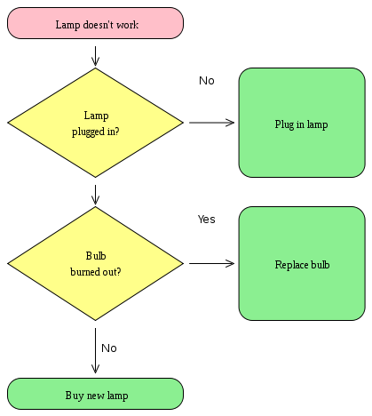
Simple Flow Chart Sample

Slide 59
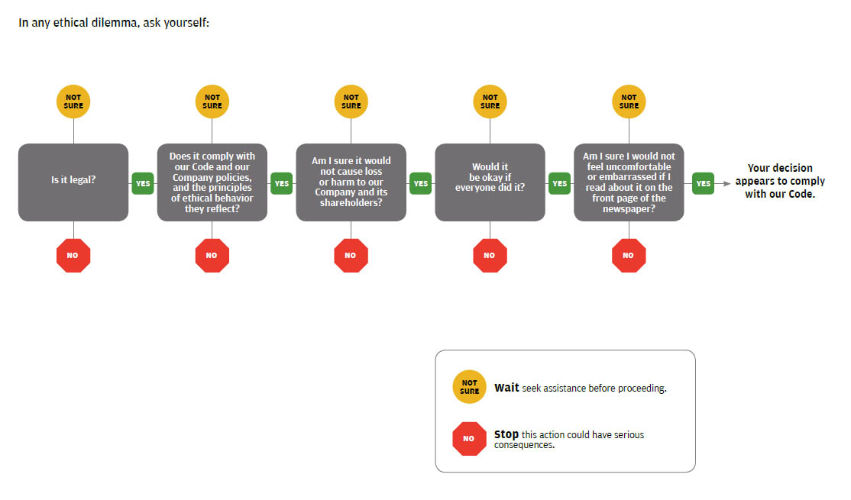
Flow Chart for Ethical Decision Making - Ethical Dilemma
4-57

Slide 60
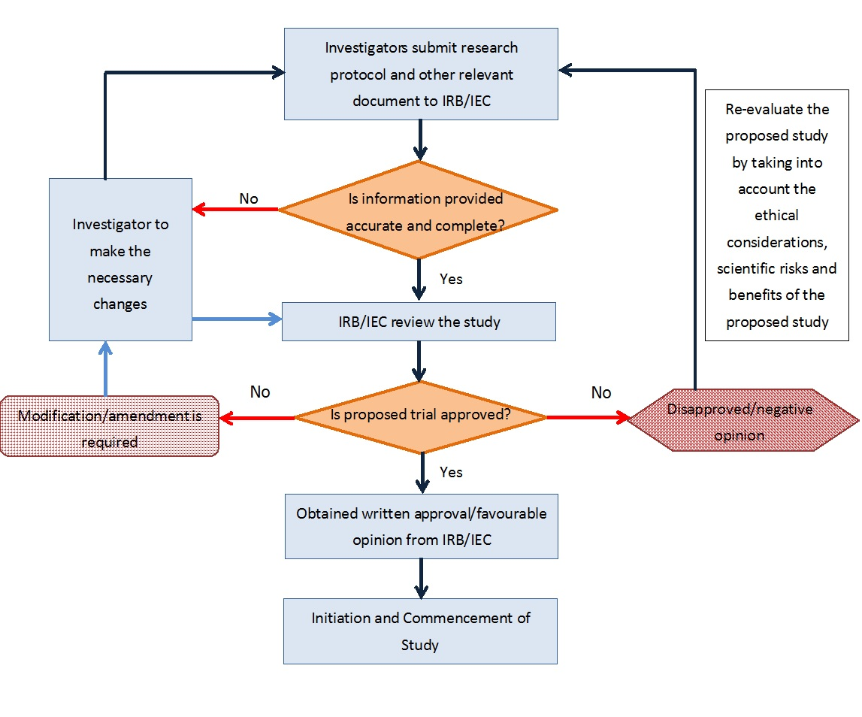
Flow Chart for Approval to Conduct a Clinical Trial
IRB: Institutional Review Board
IEC: Independent Ethics Committee

Slide 61
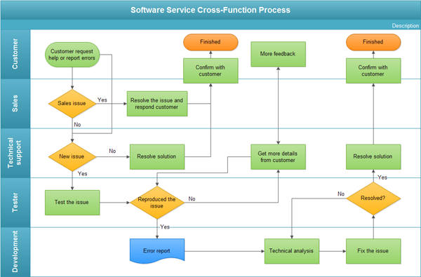
Software Service Cross-Function Process

Slide 62
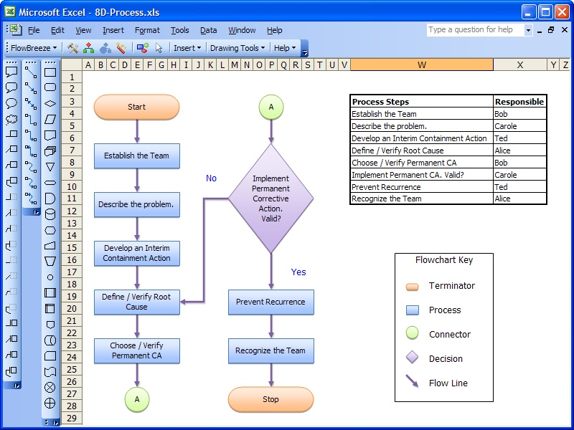
http://www.freebusinesssoftware.org/business-softwareflowbreeze-2.2-coupons.html

Slide 63
Line Drawing & Flow Chart Techniques
Sample Case
Bell’s Amusement Park
Tulsa, Oklahoma

Slide 64
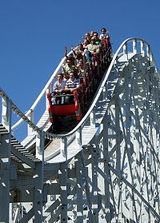
Bell’s Amusement Park ‘‘Wildcat Roller Coaster’’
Roller coaster car on the
“Wildcat Roller Coaster”

Slide 65
Accident Summary
April 20, 1997 – Two roller coaster cars collided on the ‘‘Wildcat Roller Coaster’’
Mechanical failures on the roller coaster caused a car near the top of a chain hill to disengage and roll backwards, colliding with another car
One person was killed and five others were injured

Slide 66
Causal Factors
The “chain dog”, which prevents cars from rolling backward failed to keep the first car on the track and the car slipped back and crashed into the car behind
There was no maintenance records and/or documentation for scheduled or nonscheduled maintenance of the ‘‘Wildcat Roller Coaster’’, and neither operating procedures

Slide 67
Line Drawing – Maintenance of ‘‘Wildcat Roller Coaster’’
Negative
Paradigm
Positive
Paradigm
P
3
4
2
5
1
Documentation hinders the performance of each car
Proper documentation exists and the roller coaster is acceptable
Every time the ‘‘Wildcat Roller Coaster’’ breaks down, it is documented
Operating procedures are followed for the most part
Operators haven’t been trained at all
Changes made to the car don’t need to be written down
Proper part replacements should be followed

Slide 68
Flowchart – The “Chain Dog” Factor
No
The Wildcat can operate.
Has the chain dog been changed?
Yes
A maintenance worker must inspect the changes.
Has someone inspected the changes?
No
Yes
Fix the height of the “chain dog” and inspect again.
No
Is the “chain dog” at the proper height?
Yes
The Wildcat can operate properly.

Slide 69
Line Drawing & Flow Chart Techniques
Sample Case
Whiteshell Air Service
Airplane Engine Failure

Slide 70
Accident Summary
Airplane departed without incident
After plane was leveled in air; a loud noise as a result of an explosion was heard and loss of engine power took place
Pilot landed plane in swampy area with some minor and severe injuries to passengers

Slide 71
Casual Factors
Incorrect installation of airplane parts
Failure to properly inspect airplane

Slide 72
Line Drawing – Incorrect Installation of Parts
NP
PP
P
2
3
1
Airplane parts are installed incorrectly causing immediate, fatal damage
Airplane parts are installed correctly
Parts are installed incorrectly, but corrected immediately
Parts are installed incorrectly, and cause minor damage overtime
Parts are installed incorrectly, but cause no damage overtime

Slide 73
Flow Chart –
Failure to Properly Inspect Plane
Should plane be inspected?
Have parts
been
replaced?
Had last
check within
400 hrs.?
Has pilot
noticed
irregular
sounds?
No
Yes
Yes
Inspect plane
before flying
Yes
No
No
Inspect plane
before flying
Inspect plane
before flying
Inspection
is not needed

